Slide 1
New York City Taxi Fare Prediction
Gagan arora
Shagufta pathan
Deepak khirey

Slide 2
Introduction
The New York City Taxi Fare Prediction dataset is a challenge hosted by Kaggle in partnership with Google Cloud and Coursera.
This dataset uses a selection from the massive New York City (NYC) Taxi and Limousine Commission (TLC) Yellow Cab dataset that is also publicly available on Big Query.
This is an open competition and is accepting late submissions.
Competition Link -
https://www.kaggle.com/c/new-york-city-taxi-fare-prediction#description

Slide 3
Dataset
The dataset is in the form of csv files.
The training set consists of 55M rows
The test set consists of 10K rows.
The target variable is the fare_amount (float) dollar amount of the cost of the taxi ride which is only available in the train.csv file.
Feature | Data Type | Description
pickup_datetime | timestamp | value indicating when the taxi ride started.
pickup_longitude | float | longitude coordinate of where the taxi ride started.
pickup_latitude | float | latitude coordinate of where the taxi ride started.
dopoff_longitude | float | longitude coordinate of where the taxi ride ended.
dropoff_latitude | float | latitude coordinate of where the taxi ride ended.
passenger_count | integer | indicating the number of passengers in the taxi ride.

Slide 4
Machine Learning Models Proposed
This is a Supervised Regression machine learning task
We aim to tackle this using regression algorithms
Linear Regression
Random Forest
Decision Trees
We will carry out Statistical Significance test to decide best performing model.
We will use cross-validation and hyper-parameter tuning techniques to improve accuracy of selected model.

Slide 5
Model Accuracy Metrics
We plan to use Root Mean Squared Error (RMSE) as the evaluation metric .
Same is used by Kaggle to evaluate entries.
This way we can benchmark against Public Leaderboard.
RMSE measures the difference between the predictions of a model, and the corresponding ground truth. One nice property of RMSE is that the error is given in the units being measured, so we can get directly accuracy of the model on unseen data.

Slide 6
Machine Learning Pipeline
Exploratory Data Analysis
Data Preparation
Feature Engineering
Model evaluation
Model Optimization
Pipeline Execution

Slide 7
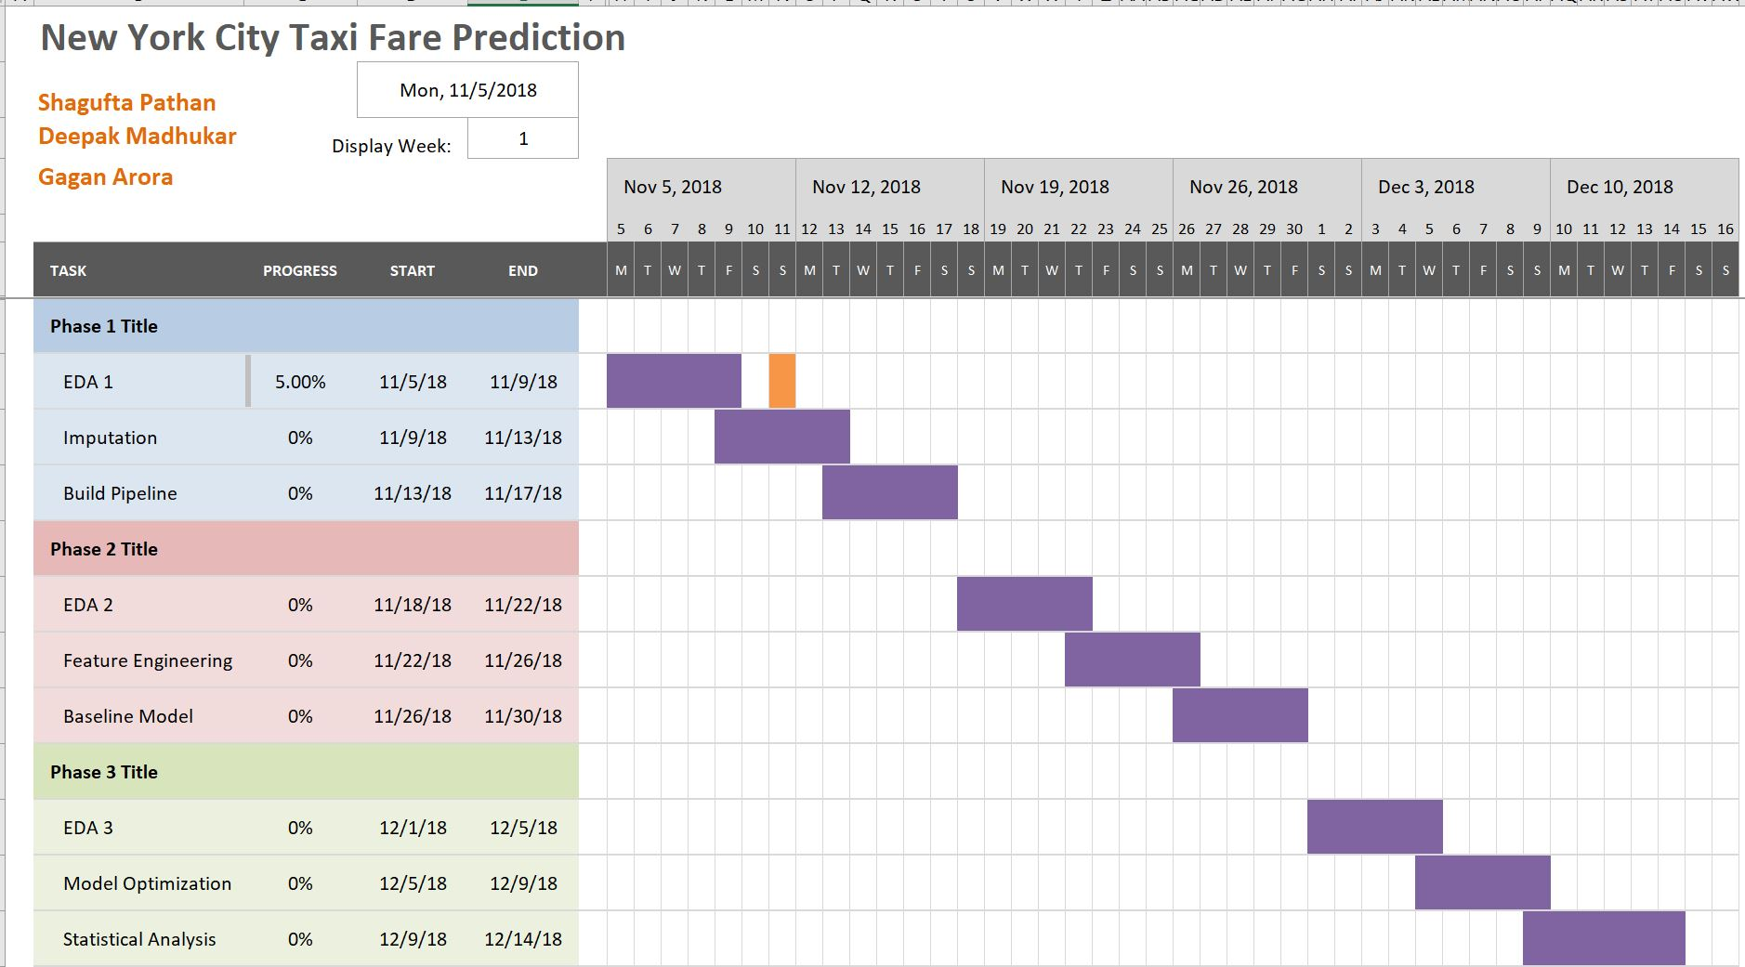
Project Timeline

Slide 8
Team Work
Gagan | Deepak | Shagufta | Team Effort
Data Cleaning including imputation of missing values, removing outliers etc. Building SkLearn pipelines | Basic EDA (1) Model Optimization using hyperparameter tuning techniques | Baseline Models Feature Engineering/ Feature Selection Basic EDA (2) | Integrating SKLearn pipelines Discussions, results and conclusions Creating slides and presentation.

Slide 9


